Slide 1




ECN the identifier of a new service model
Bob Briscoe, BT
Mirja Kuhlewind, David Wagner, Stuttgart Uni
Koen De Schepper, Alcatel-Lucent
IETF-89 TSVAREA
Mar 2014
Bob Briscoe & Koen de Schepper are part-funded by the European Community under its Seventh Framework Programme through the
Reducing Internet Transport Latency (RITE) project ICT-317700

Slide 2
outline
classic ECN wasn’t useful enough to deploy
opportunity to identify a new service model using ECN
  consistent low delay service for all
incremental deployment path
take-home message for AQM implementers:
    please allow ECN & loss parameters to be independent

Slide 3
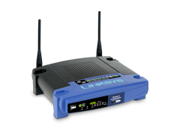
classic ECN just avoiding loss has not been good enough
classic ECN = “drop equivalence”
    networks & hosts treat ECN & drop identically [RFC3168]
cannot justify the deployment pain*
    ECN largely off-by-default in Internet clients
for a small performance gain
    loss levels are low, and falling
    applications can find other ways to mask losses
ECN can do so much better...
* 2001: arbitrary blocking by firewalls & NATs – largely fixed by 2003
2002-2007: IP/ECN packets triggered 1 bugged home gateway model to crash and 4 to increase drop
2009: some border gateways started zeroing ECN – fixes were rapidly deployed

Slide 4
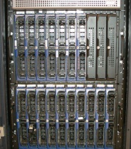

Immediate ECN +
Smooth TCP response
smoothing
congestion signals
inspired by Data Centre TCP (DCTCP)
  AQM: Immediate ECN – remove sluggish signal smoothing
  TCP decrease: proportionate to ECN feedback over an RTT
    deployed extensively in ECN data centres
translate this approach to the public Internet?
  more gain
    promise of consistent low delay for all
  less pain
    removes sensitivity of AQM to sluggish RTT setting
    can start with existing hardware, firmware or software

Slide 5
consistent low delay for all
Today (at best)
TCP on end-systems
AQM at bottlenecks
if change bottlenecks alone
change bottlenecks
and TCP
buffer kept for bursts
buffer
occupancy
b u f f e r s i z e
TCP saw-teeth seeking
the operating point
smooth TCP:
more smaller
saw-teeth
queue
management
operating point
shallower
operating
point
lower queuing delay
line
utilisation
good line utilisation
cuts delay but poorer line utilisation
time
and highly insensitive
to threshold config

Slide 6
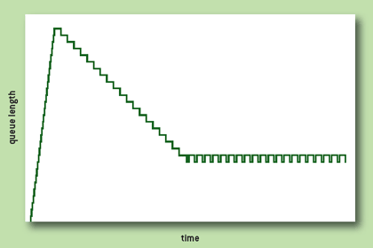
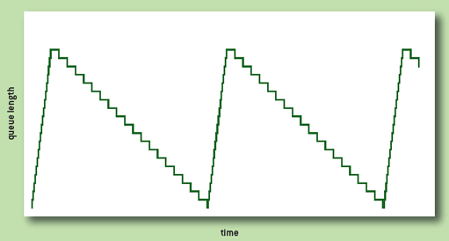



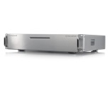
    RTT auto-tuning
good(?)
queue
good(?) queue
bad
queue
Drop
new AQMs defer dropping for ~100ms (worst-case RTT)
    no response for 5 CDN RTTs, or 25 media server RTTs
ECN
AQM can signal ECN immediately – no risk of impairment
the transport can smooth out ECN bursts if it chooses
  it knows if it’s RTP or TCP in slow-start or cong-avoidance
then a transport’s smoothing delay is only its own RTT
  short RTT flows can fill troughs and absorb peaks
  no need to make all flows as sluggish as the worst-case RTT
continues progress towards zero config
  line-rate auto-tuning: ARED ✓CoDel ✓ PIE ✓
  round-trip auto-tuning: Shift smoothing to hosts ✓
100ms
origin
20ms
CDN
4ms
home
media
server

Slide 7
deployment problem #I: co-existence of smoothed traffic and existing traffic
data centre TCP was so-called only because it couldn’t co-exist with Internet traffic
for Internet: can’t have a low delay threshold for ECN
and a deep threshold for drop
in one FIFO queue
drop traffic would
push the queue to its
own balance point
causing 100% marking
of ECN packets
then ECN traffic would starve itself
1
✗
ECN
drop
packet mark/drop
probability
0
Queue

Slide 8
problem #1 co-existence: solution initially use existing network hardware
use weighted RED (WRED) implementation
in an unusual configuration
  one FIFO queue with two instances of RED algo
    smoothed queue for drop (EWMA-constant = 9 say)*
    instantaneous queue for ECN (EWMA-constant = 0)
may require new firmware / software
similar approach possible
for ECN in (fq_)CoDel & (fq_)PIE
  please ensure parameters for
  ECN & drop are independent
1
ECN
drop
0
Inst. queue
Smoothed queue
* if exponential-weighting-constant = B,
then RED smooths the queue over 2^{B} packets
if B = 9, RED smooths over 2⁹ = 512 packets
if B = 0, RED smooths over 2⁰ = 1 packet (i.e. it doesn’t smooth)

Slide 9
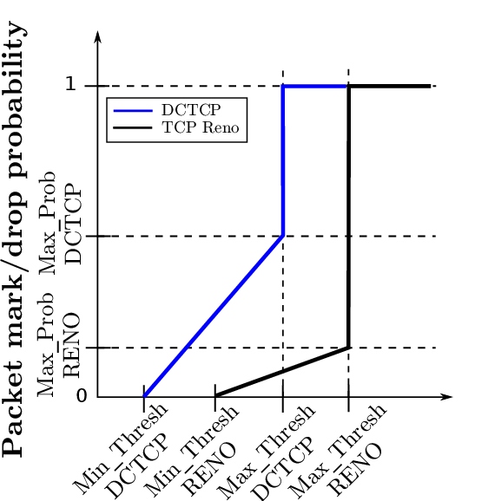
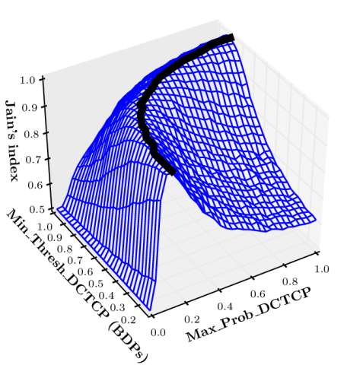
problem #1 co-existence: solution results of testing so far
1
goals: a) robust against starvation; b) rough rate equality
simulated large part of the much larger parameter space
    paper under submission, available on request
curve fit implied an analytical solution would exist
derived relation between ECN & drop curves
  such that n ECN-DCTCP flows and m drop-Reno flows
  would all have equal rates for any n & m
next steps:
  test theory by simulation
  test whether an approximation to the curve is good enough
ECN
drop
Averaged
Queue
q(w_{q})
2
3
p_{drop} = 0.4p²_{ECN}
1
1
ECN
drop
both feasible
alternatives
ECN
drop
packet mark/drop
probability, p
0
Inst. queue
Smoothed queue
0
Inst. queue
Smoothed queue
* by Juan Manuel Reyes Espinosa

Slide 10

deployment problem #2: solution incremental deployment interop between classic and immediate ECN
smoothed TCP (sndr) requires ‘accurate ECN feedback’ (rcvr)
  tied together by accurate feedback negotiation during 3WHS
server: ECN on-by-default in majority of servers
client: turn ECN on-by-default in client when deploying:
  accurate ECN feedback + ECN fall-back
transport buffers | small smoothed responses to each ECN | one big instant response to ECN per RTT
immediate ECN | ✓ | ✓¹
smoothed ECN | ✓² | ✓
smoothing
congestion signals
smoothing
congestion signals
classic
¹ more marks from network, but one response per RTT at sender
don’t get smoother latency until host upgrades as well
(see Tuning ECN for data center networks, Microsoft Research Asia, In Proc CoNEXT’12)
² doubly smoothed response to congestion
these two ticks are based on conjecture, not experimental evidence (yet)

Slide 11
cross-layer / cross-wg impact on IETF
 | problem | IETF wg formed
1 | real-time media congestion avoidance | rmcat
2 | prevent TCP bloating queues | aqm
3 | prevent TCP’s swings in delay | -
 | component | IETF wg | document
3.1 | redefine meaning of ECN CE | tsvwg | Expt update to RFC3168
3.2 | specify ECN behaviour in AQM algos | aqm | CoDel, PIE, ARED
3.3 | specify change to TCP feedback | tcpm | draft-ietf-tcpm-accecn-reqs draft-kuehlewind-accurate-ecn
3.4 | specify change to TCP sender algo | tcpm | draft-bensen-tcpm-dctcp
RFC 3168 may not need to be updated (see spare slide)
urgent, given pace of AQM development
wire protocol: the main standards track change
algorithm experimentation expected

Slide 12
Immediate ECN concluding messages
promise of consistent low delay for all
    host uses smoother sawteeth
    immediate signals during dynamics
    not delayed for a worst-case round trip
removes hard-coded round-trip-time from AQMs
can use existing network hardware
AQM implementers note well:
    research in progress
    but please allow ECN & loss parameters to be independent

Slide 13
Immediate ECN
Q&A
Q1: if subsequent experiments are as promising as these,
would there be an appetite in the transport area
to tweak the meaning of ECN?
spare slides

Slide 14
flow separation (FQ_AQM) isolates me from other TCP sawteeth?
it doesn’t isolate me from my own sawteeth
    queue varying between 0-1 RTT unavoidable in access links
    video delivery over TCP needs larger play-out buffer
flow separation
  implies you have to choose the scheduling policy
    IPSec VPNs – FQ gives them 1 flow’s share
    variable rate video wants to vary its share
    LEDBAT wants to take less than its share
  end-to-end principle
    look very hard for an alternative before you break it
?

Slide 15
which codepoint for immediate ECN?
To use CE for immediate ECN,
may not need to update RFC3168 (Addition of ECN to IP):
  ...if the ECT codepoint is set in that packet's IP header ... then instead of dropping the packet, the router MAY instead set the CE codepoint in the IP header.
  An environment where all end nodes were ECN-Capable could allow new criteria to be developed for setting the CE codepoint, and new congestion control mechanisms for end-node reaction to CE packets. However, this is a research issue, and as such is not addressed in this document.
  Could use ECT(1) for immediate ECN
    but this unnecessarily wastes the CE codepoint
    (who would want ‘sluggish ECN’?)

Slide 16
a similar coexistence approach should be applicable to other AQMs
ultimately, want to auto-tune against line-rate and RTT
  use a modern AQM that uses queuing delay as its metric
  and separate drop and ECN algos
message for implementers (esp. in silicon)
    ensure parameters can be configured independently for ECN
AQM | smoothing parameter | non-ECN packets | ECN packets
ARED | ewma-const | 9 | 0
PIE | max_burst | 100ms | 0
CoDel | interval | 100ms | 0

Slide 17
immediate and shallow ECN?
1
ECN
drop
to avoid starvation in any scenario
    if FIFO, min thresholds for ECN & drop
    need to be the same
    (in theory – to be tested)
first immediate ECN only
    incentivises initial deployment
    performance gain only from immediate ECN
    not from a shallow threshold
    cannot risk lower utilisation for prevalent non-ECN traffic
later, immediate and shallow ECN with shallow drop
    must shift both thresholds together
    as ECN traffic becomes prevalent
      smoother ECN traffic will maintain high utilisation
      also more insensitive to config
✗
0
Inst. queue
Smoothed queue

Slide 18
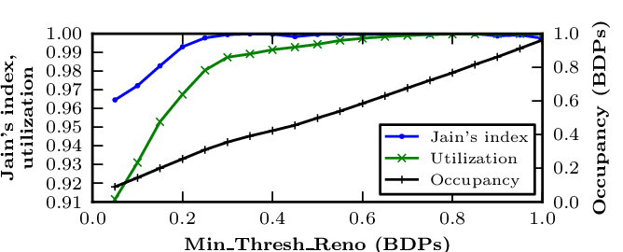
co-existence results of ‘gating tests’
explored large part of the much larger parameter space
    implemented in Linux 3.2.18; simulated in IKR simlib
    ‘gating tests’: long-running flows only
    paper under submission, available on request
robust against starvation
formula to derive
ECN config from drop config
to maintain rate fairness
can then find sweet spot
for the drop config
ECN
drop
Averaged
Queue
q(w_{q})

Slide 19
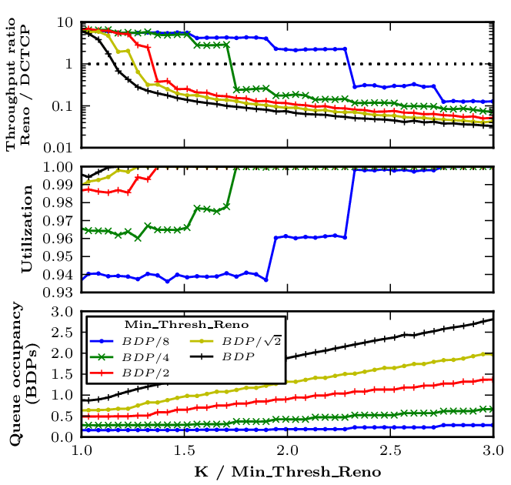
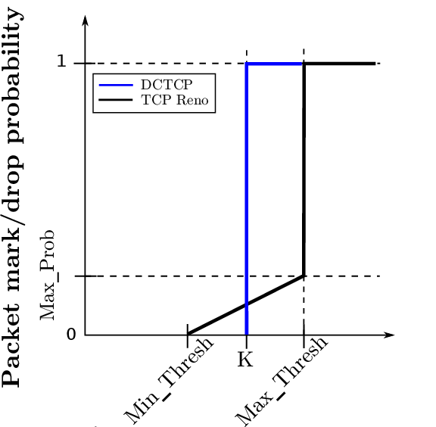
a sample of the results so far
ECN
drop
Instantaneous queue
Averaged queue
(w_{q})
early deployment, when traffic mostly drop-based
have to set drop (and therefore ECN) threshold deep
as more flows shift to DCTCP,
can set both thresholds shallower

Slide 20
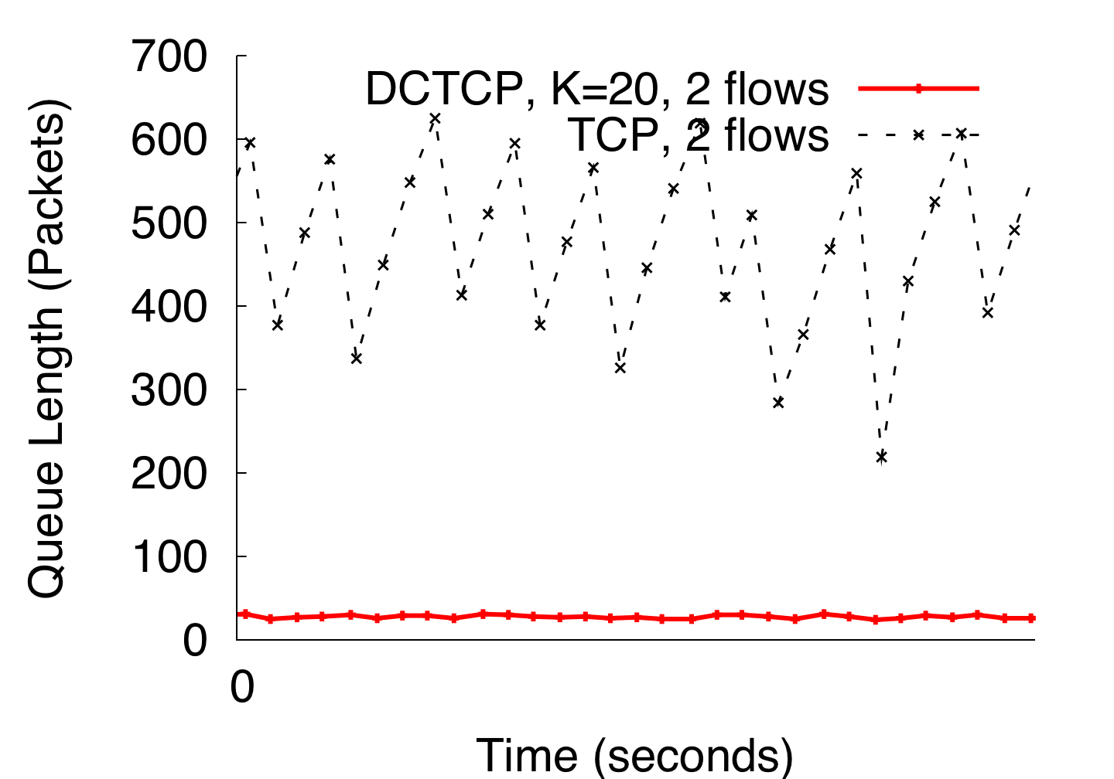
DCTCP in Action
(Kbytes)
Setup: Win 7, Broadcom 1Gbps Switch
Scenario: 2 long-lived flows, K = 30KB
20
Notes:
Not ns2.
K = 30KB => 20 packets
20

Slide 21
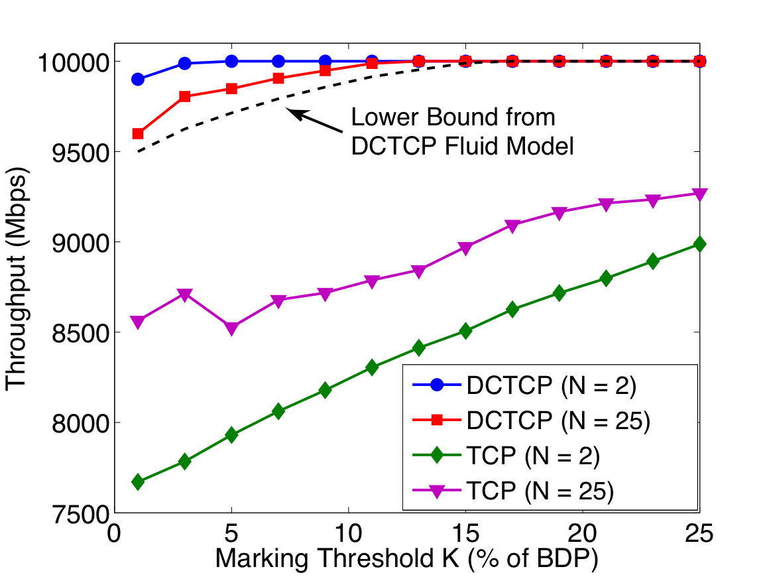
Throughput-Latency Tradeoff
Throughput > 94% as K → 0
For TCP:
Throughput → 75%
Parameters:
link capacity = 10Gbps
RTT = 480μs
smoothing constant (at source), g = 0.05.
18
Notes:
Bandwidth-delay product = 400 x 1500B packets

Slide 22
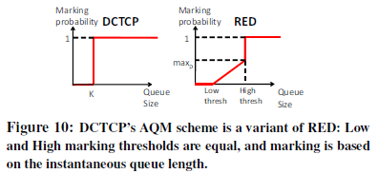
DCTCP activity
Averaged
Figures courtesy of Alizadeh et al
E2e Transport
  In Windows 8 Server
  data center template
  I-D for DCTCP feedback (intended EXP)
  [draft-kuehlewind-tcpm-accurate-ecn-01]
AQM
  Existing kit: Just a degenerate config of RED
  Can be implemented as just a step at K packets (single ‘if’ command)
  For zero-delay can use a virtual queue [RC5670]
    hardware implementations [“How to Build a Virtual Queue from Two Leaky Buckets”]
    see HULL for specifics with DCTCP
Analysis, papers, Linux & ns2 implementation, etc
  <http://www.stanford.edu/~alizade/Site/DCTCP.html>
  SIGCOMM paper gives entry point

Slide 23
Data Center TCP Algorithm
Switch side:
Mark packets when Queue Length > K
B
K
Don’t
Mark
Mark
  Sender side:
  Maintain moving average of fraction of marked packets (α)
  Adaptive congestion window decrease:
Notes:
very simple marking mechanism
not all the tunings other aqms have
on the source side, the source is tryign to estimate the fraction of packets getting marked
using the obs that there is a stream of ecn marks coming back – more info in the stream than in any single bit
trying to maintain smooth rate variations to operate well even when using shallow buffers, and only a few flows (no stat mux)
F over the last RTT. In TCP there is always a way to get the next RTT from the window size. Comes from the self-clocking of TCP.
Only changing the decrease. Simplest version – makes a lot of sense. So generic could apply it to any algorithm – CTCP, CUBIC – how to cut its window leaving increase part to what it already does. Have to be careful here.
23

